Slide 1

Pittsburgh Data Jam 2017-2018
Bringing Big Data Education and Awareness to Pittsburgh High School Students
November 1, 2016

Slide 2
Introductions
Saman Haqqi - President - Pittsburgh Dataworks
saman.haqqi@pghdataworks.org
Brian Macdonald – Data Scientist – Oracle Corporation
brian.macdonald@oracle.com
Pitt Science Outreach – Judy Cameron - cameronjl@upmc.edu
Margaret Farrell
Laura Marshall
Jenny Lundahl ------ PittsburghDataJam@pitt.edu
Jackie Choffo http://www.pittscienceoutreach.com/content/pittsburgh-data-jam
Kyle Wiche
Evan Becker
Chris Davis

Slide 3
Who is Here?
Yes someone has to speak

Slide 4
Mentors
Each team will be assigned a mentor
Can ask questions via email at any time
Copy everyone on your team
Copy your teacher
Pitt Science Outreach students
Send email to all
Have a regular scheduled call with your mentor
Don’t wait to right before presentations.

Slide 5

Data Analysis Workshop Today’s Goals
Identifying relevant variables
Depicting them graphically
Doing the analysis
Drawing conclusions
Making recommendations

Slide 6








What technology will you use?
Lots of tools are available
Keep it simple at the beginning
Use Excel
Tableau is also available
Many Others
R, SAS, Cognos, Oracle Business Intelligence, Google Apps, Matlab, Pyhton, Spotfire, QlikView

Slide 7

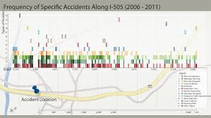
Data Analysis Process
A standard repeatable process to guide data analysis.
Used formally and informally
If you do analysis, you will do these steps.
Used for Big Data or not so Big Data
Becomes second nature as you do more analysis.
Is not about using a cool data analysis tool
Although they are extremely helpful.

Slide 8
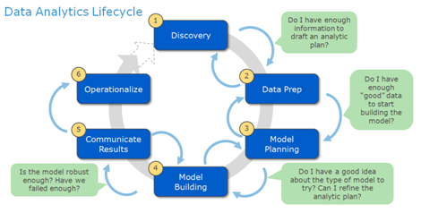
The Data Analysis Process
In practice it looks like this
Define your Problem
Identify Data
Plan your Analysis
Explore Data
Prepare Data
Model Data
Tell A Story
Make Recommendations
Determine What’s Next
Today’s Focus
https://cyberitgs.wikispaces.com/Sandbox+Yerlan

Slide 9
Basic Steps for Analysis
Data Exploration
Data Preparation
Build Models

Slide 10


Data Exploration Exploratory Data Analysis (EDA)
Goal is to get an understanding of what data you have
What are your variables
Basic Statistics
Graph Data
Look for missing values
Look for outliers
Will this data help you answer your question?

Slide 11
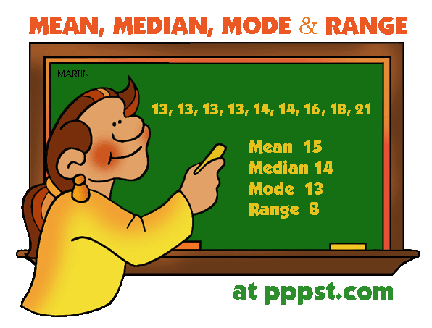
Basic Statistics
Goal is to get a basic understanding of your data
Mean (Average)
Sum of values/Count of values
Median
Mid Point of Values
Maximum, Minimum (Range)
Standard Deviation (σ) & Variance (σ^2)
How spread out the values are compared to the mean
Quartiles
Nice buckets of the spread of the data

Slide 12
Demo - Statistics in Excel

Slide 13
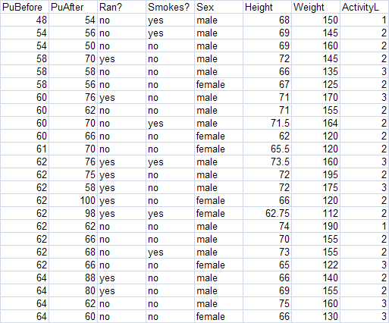
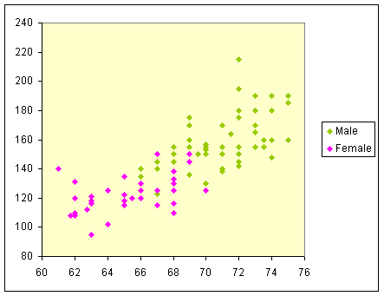
Graphing Data
Helps visualize patterns in the data
Especially with large data sets.
https://www.mapbox.com/labs/twitter-gnip/locals/#12/40.4620/-80.0151
Spot exceptions
Use the best graph for the data types
Help tell your story

Slide 14
Demo - Graphing in Excel

Slide 15

Missing Values
Can have large impact on basic statistics
Count # of missing values of every variable (column)
Important to understand why data is missing?
Data entry
Wasn’t collected
Isn’t relevant
Should you use the variable?
Should you fill in missing values
Use mean, median, max, min, 0.
You need to determine best method

Slide 16

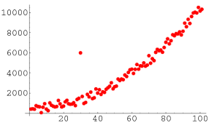
Outliers
Outliers are values at the extreme
Much larger or smaller than most of your data
May have many causes
Data Entry Error
Instrument Malfunction
Real Exceptional data
Is 140º F an Outlier
Some are easy to spot within a single variable
Some are only found with multiple variables

Slide 17
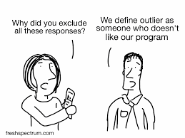
Outliers
Need to decide how to treat Outliers
Is the variable ok to use? Do you question the validity of the data?
Remove them from your data set?
Keep them as is?
Change the value (i.e. make it less extreme)
Infer the real meaning
-90º F temperature in Miami is likely 90º
Make sure you understand implications
Document your decision making

Slide 18
Demo – Missing Values & Outlier Detection in Excel

Slide 19
One Last Thought on Exploring Data You must be observant
Count the Number of F’s in the following sentence.
You will have 15 Seconds
FINISHED FILES ARE THE RE- SULT OF YEARS OF SCIENTIF- IC STUDY COMBINED WITH THE EXPERIENCE OF YEARS.

Slide 20
Leave your assumptions at the door!
FINISHED FILES ARE THE RE- SULT OF YEARS OF SCIENTIF- IC STUDY COMBINED WITH THE EXPERIENCE OF YEARS.

Slide 21

Exploration Exercise
Using Excel
Sort
Filter
Summarize
Create Crosstabs
Charting

Slide 22
Basic Steps for Analysis
Data Exploration
Data Preparation
Build Models

Slide 23
Data Preparation
This step will fix any issues you found during data exploration
Fix missing values
Remove bad data
Create new variables
Add/Subtract/Multiply/Divide multiple variables
Ratios
Binning
Other functions like Square Root or Exponents
Anything else you feel appropriate
Have fun and experiment. You can not hurt data.

Slide 24
Demo – Data Preparation

Slide 25
Preparation Exercise
Using Excel
Merge data
New Calculations
Fix Missing Data
Fix Outliers

Slide 26
Basic Steps for Analysis
Data Exploration
Data Preparation
Build Models

Slide 27
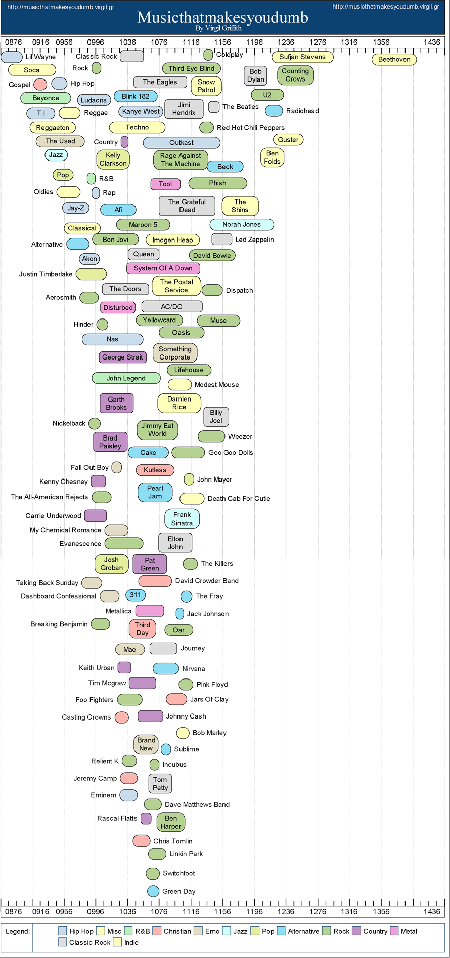
Explaining Insights
How do you know what you see is valid?
And not due to chance?
Correlation
http://musicthatmakesyoudumb.virgil.gr/

Slide 28
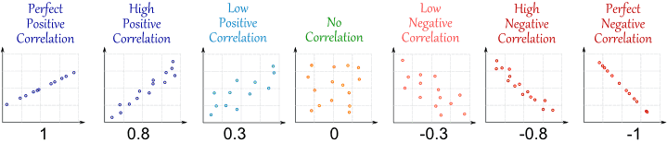
Correlation
The degree to which two or more attributes or measurements on the same group of elements show a tendency to vary together
Positive when values increase together
Negative when values decrease together
http://www.mathsisfun.com/data/correlation.html

Slide 29
What can you tell me about this graph?
Ice Cream consumption/capita
Drownings

Slide 30
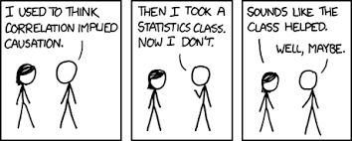
Does Ice Cream Consumption Cause Drowning?
Obviously not
Correlation does not imply Causation
One may cause the other, but correlation just defines how they vary.
There may be other reasons. i.e. Hot temperatures
Be very cautious with Causation
There are tests to determine causation

Slide 31
How do I know if variables are correlated
Understanding R and R²
R = Correlation Coefficient
Values between -1 & 1
Positive Correlation > 0 - As one variable increases, the other increases
Perfect Correlation = 1
Negative Correlation < 0 - As one variable increases, the other decreases
Perfect Negative Correlation = -1
0 = No correlation
Can be shown with a trend line

Slide 32
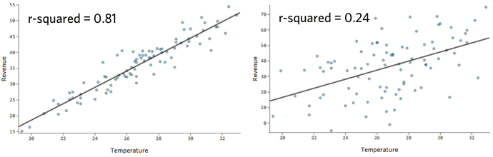
How do I know if variables are correlated
Understanding R and R²
R² = Coefficient of Determination
Tells how likely one variable predicts the other variable
Values between 0 & 1
If R ² = 0.850, 85% of the total variation in y can be explained by the linear relationship between x and y
R² is more commonly used

Slide 33
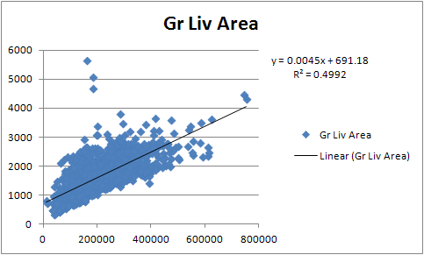
Some Terminology
Slope Intercept
Independent Variable
These are the variables that you modify
In trend equation they are the X values
Dependent Variable
These values depend on the values of the Independent variables.
In trend equation they are the Y values
y = 0.0045x + 691.18
y is Living Area
x is Sale Price

Slide 34
Demo – Modeling Data

Slide 35
Modeling Exercise
Using Excel
Create scatter plot
Show Coefficient of determination
Create a formula to predict a value

Slide 36
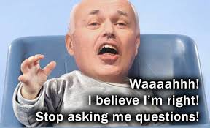
What did the Data Tell You
Did it support your initial question?
What conclusions can you make?
Make sure they are fact based
Check your bias
What is your story?
Is it compelling?
Does x influence y?
Can it support actions to be taken?
If not, is there still some benefit?

Slide 37

What did the Data Tell You
What recommendations will you make?
Will you stand behind them?
If not, why not?
Can they really be implemented?
What is the value of implementing the recommendation
What new questions would you ask?
To clarify your analysis?
Expand on your analysis
Can better questions be asked?

Slide 38
And the most important Item
Have Fun

Slide 39
Example Data Jam Project
Overview of Sample Data Analysis Project
Finding data
Do the analysis
Make a visual presentation
Present Conclusions

Slide 40
Questions?
Always ask questions!!!!

Slide 41
Timing
Introductions – 15 Minutes – 8:45
Overview/Data exploration Lecture 40 Minutes – 9:25
Exploration Hands-on – 30 Minutes – 9:55
Data Prep Lecture – 30 Minutes – 10:25
Data Prep Hands-on – 30 Minutes – 10:55
Data Modeling Lecture – 30 Minutes – 11:25
Data Modeling – Hand-on – 30 Minutes – 11:55
Questions/Wrap Up – 20 Minutes – 12:15
Sample Presentation 15 Minutes – 12:30
Total 3:00

